Slide 1

TITLE:
TECHNICAL INTERVIEW
PREPARATION PORTAL
BY
1.18JG1A0583 SAHITHI SARIKA PONNADA
GUIDE : Satheesh

Slide 2
ABSTRACT :
The main objective of this project is to have a quick reference of all core subjects and general questions as well within a short period of time . It has admin , userlogin and signup pages . They are three streams computers or information technology , electronics and electrical and each of the stream has its respective companies . If student have any queries they can post them in the query page and check the answers in answer page . Admin can view student queries after logging in and respond to their queries by posting the answer.

Slide 3
INTRODUCTION :
Interview skills are an essential tool for all students in today’s world as there is increasing competition . The most important step to landing a job is being prepared for your interview . By doing some preparation you will feel more in control , and will appear cool , calm and collected . There are four basic steps you should take when preparing for an interview research yourself , practice , research the company and prepare logistically . It is important to organize a suite of compelling examples to convince the interviewer.

Slide 4
REQUIREMENTS :
DJANGO : Django is a free and open source web application framework, written in Python. A web framework is a set of components that helps you to develop websites faster and easier . Django is a collection of Python libs allowing you to quickly and efficiently create a quality Web application, and is suitable for both frontend and backend.
XAMPP : XAMPP is one of the widely used cross-platform web servers, which helps developers to create and test their programs on a local webserver.
HTML : HTML stands for Hyper Text Markup Language · HTML is the standard markup language for creating Web pages. HTML describes the structure of a Web page.
CSS : CSS stands for Cascading Style Sheets.CSS describes how HTML elements are to be displayed on screen, paper, or in other media.CSS saves a lot of work. It can control the layout of multiple web pages all at once.
BOOTSTRAP4 : Bootstrap 4 is the newest version of Bootstrap. Bootstrap is a potent front-end framework used to create modern websites and web apps. It's open-source and free to use.

Slide 5
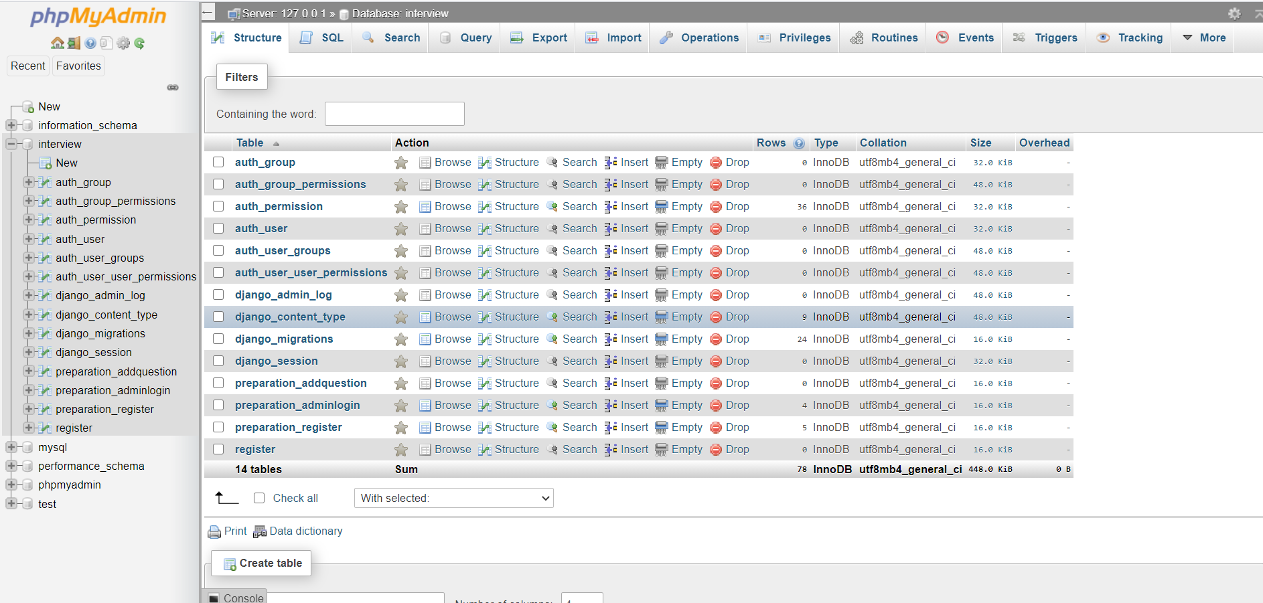
. Tables created
DATABASE TABLES

Slide 6
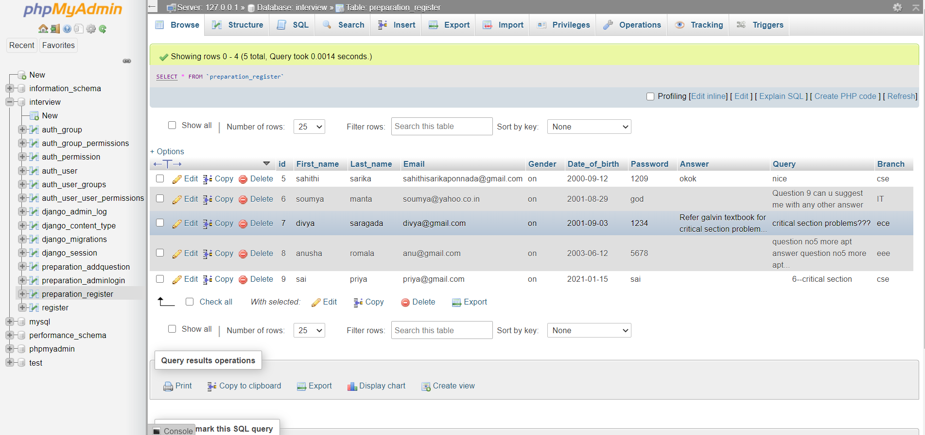
.Signup table

Slide 7
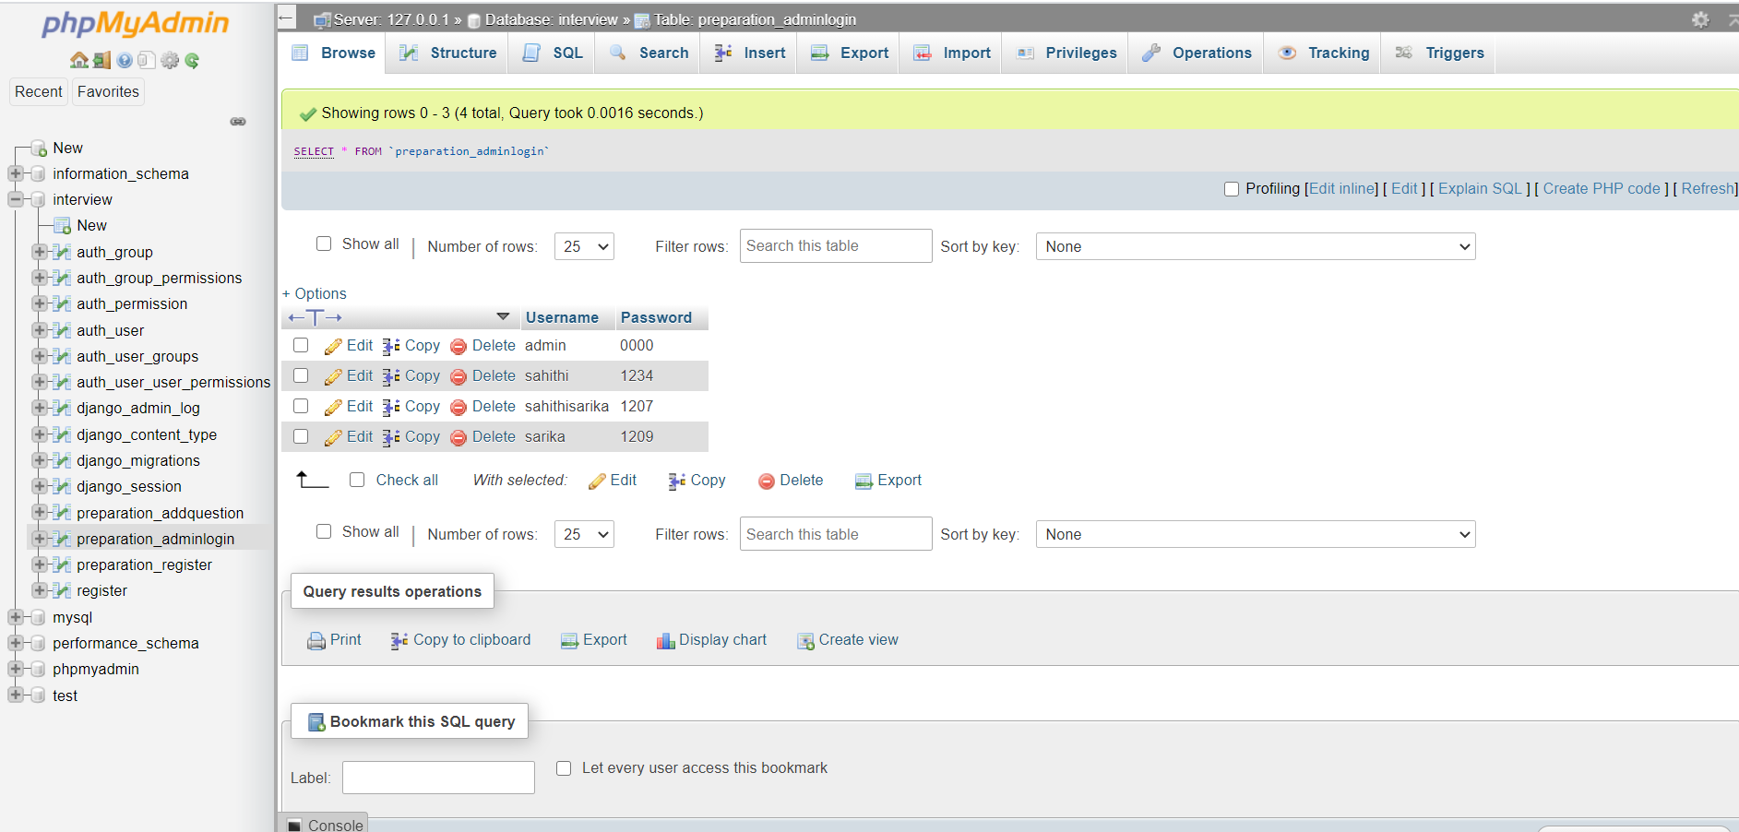
.Admin Login table

Slide 8
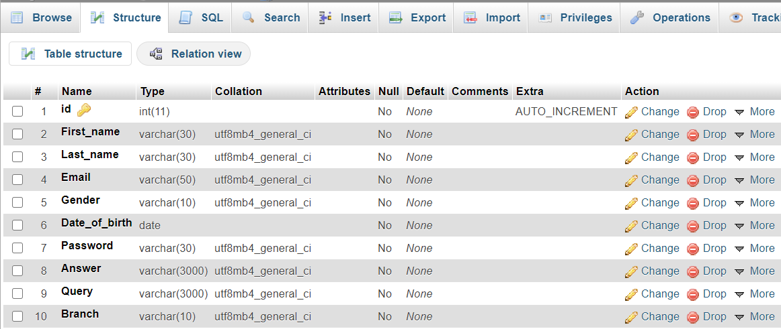
SCHEMA
. signup

Slide 9
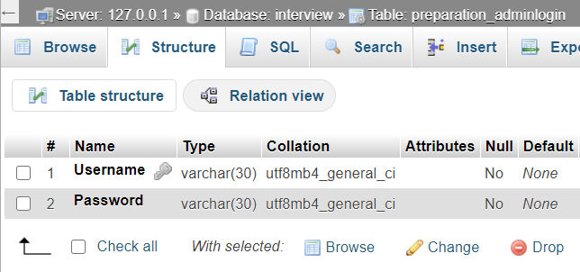
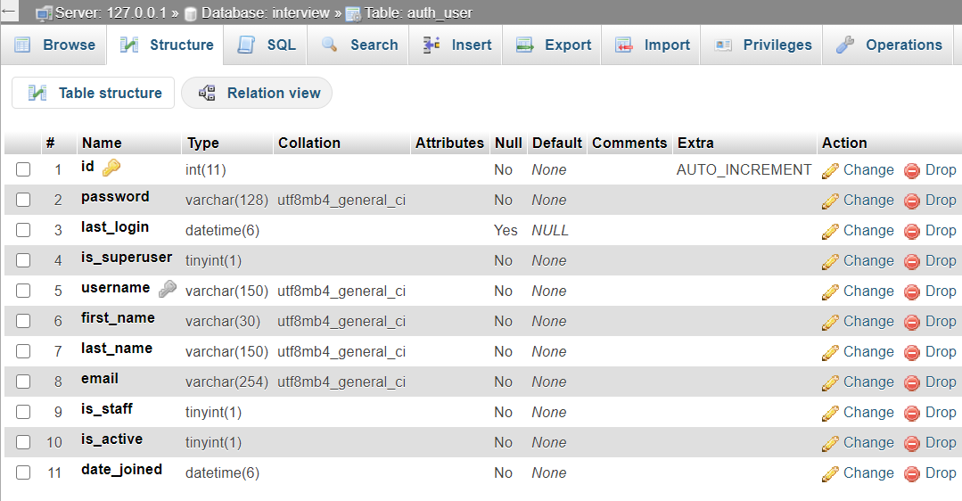
. Admin login
. User authentication

Slide 10
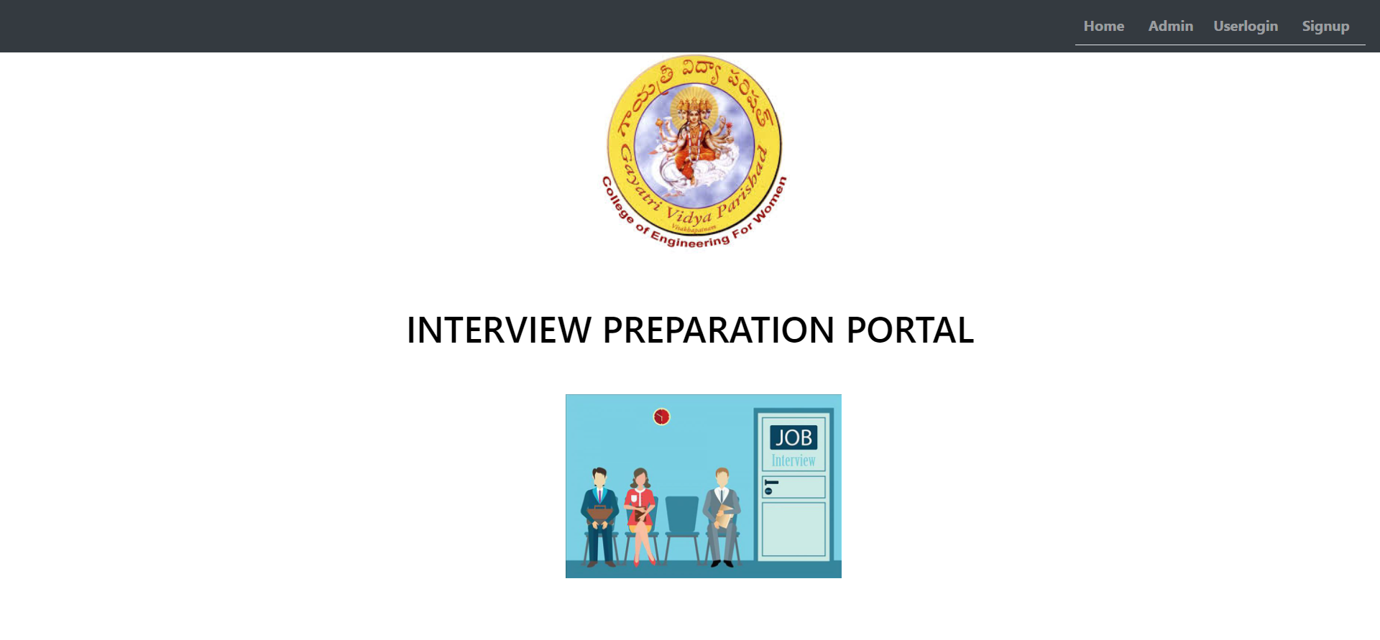
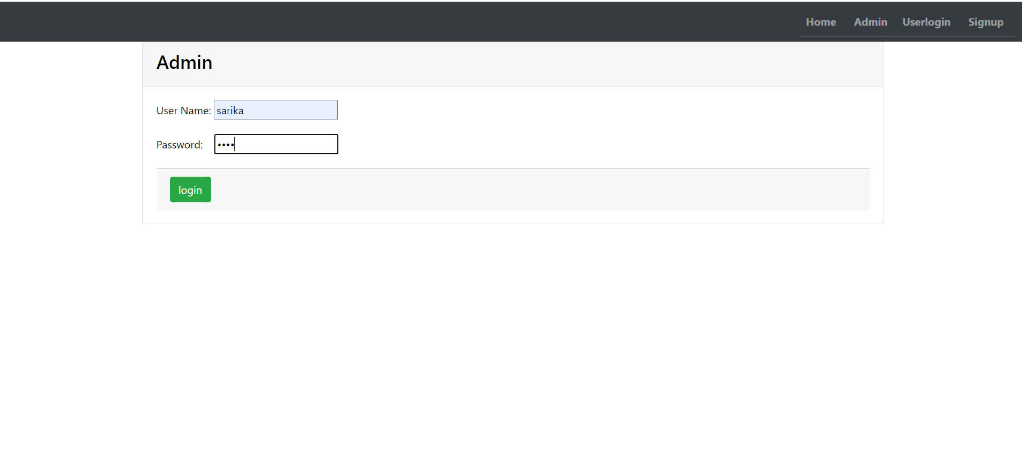
Results
fg2
fg1
fg2

Slide 11
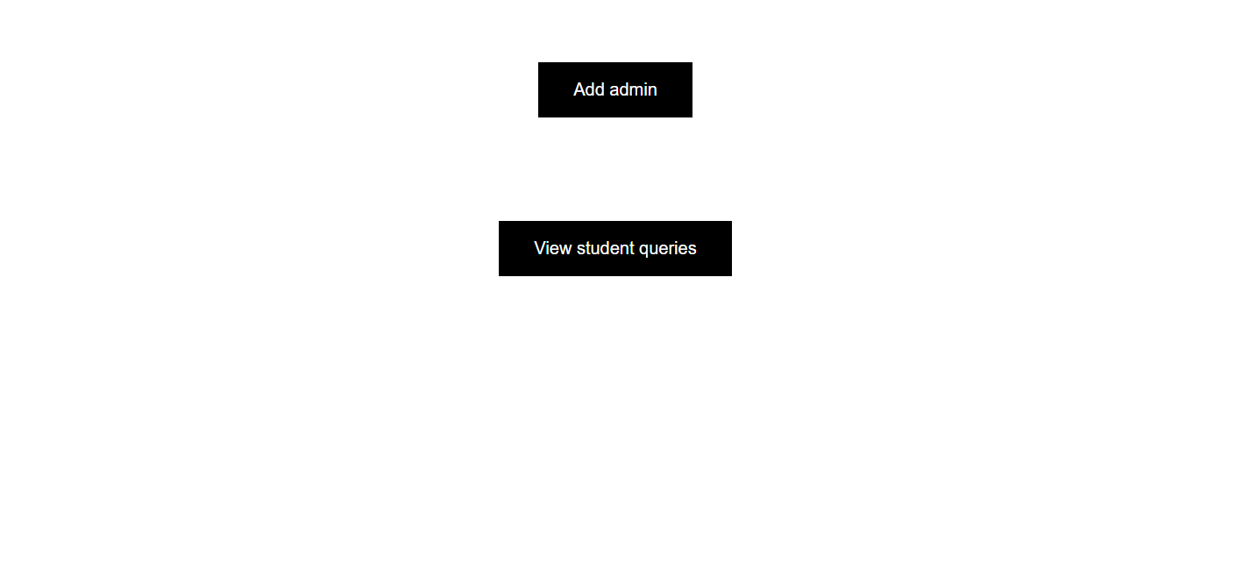
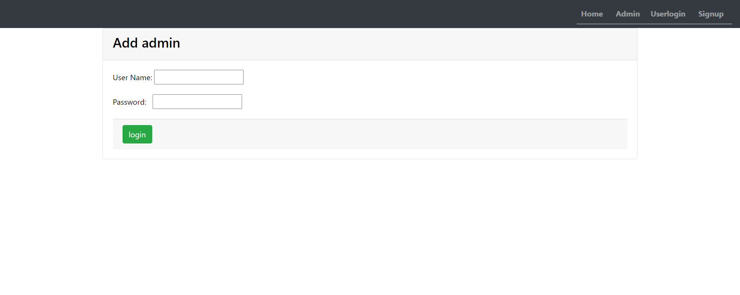
fg3
fg4

Slide 12
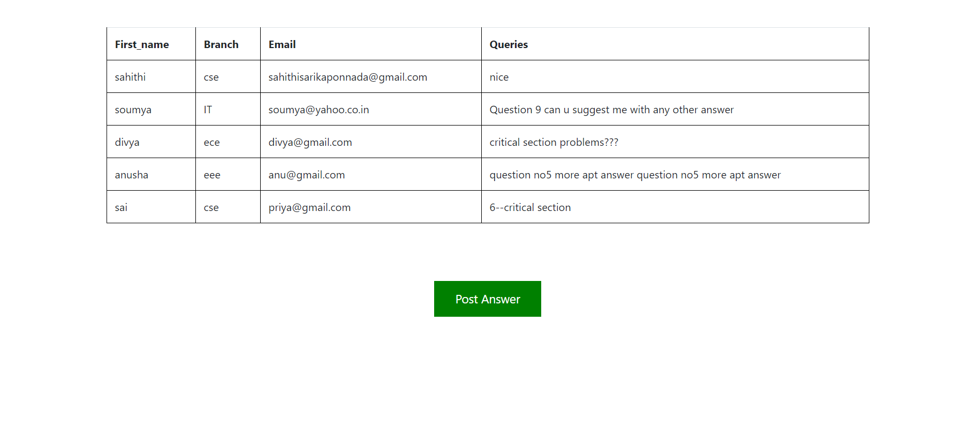
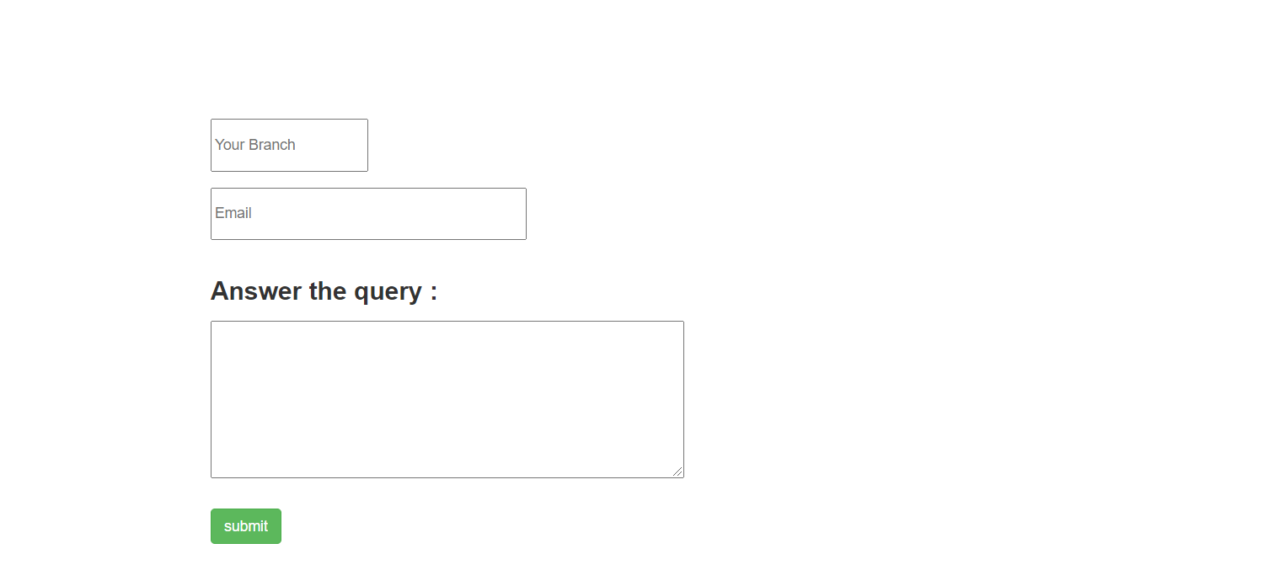
fg5
fg6

Slide 13
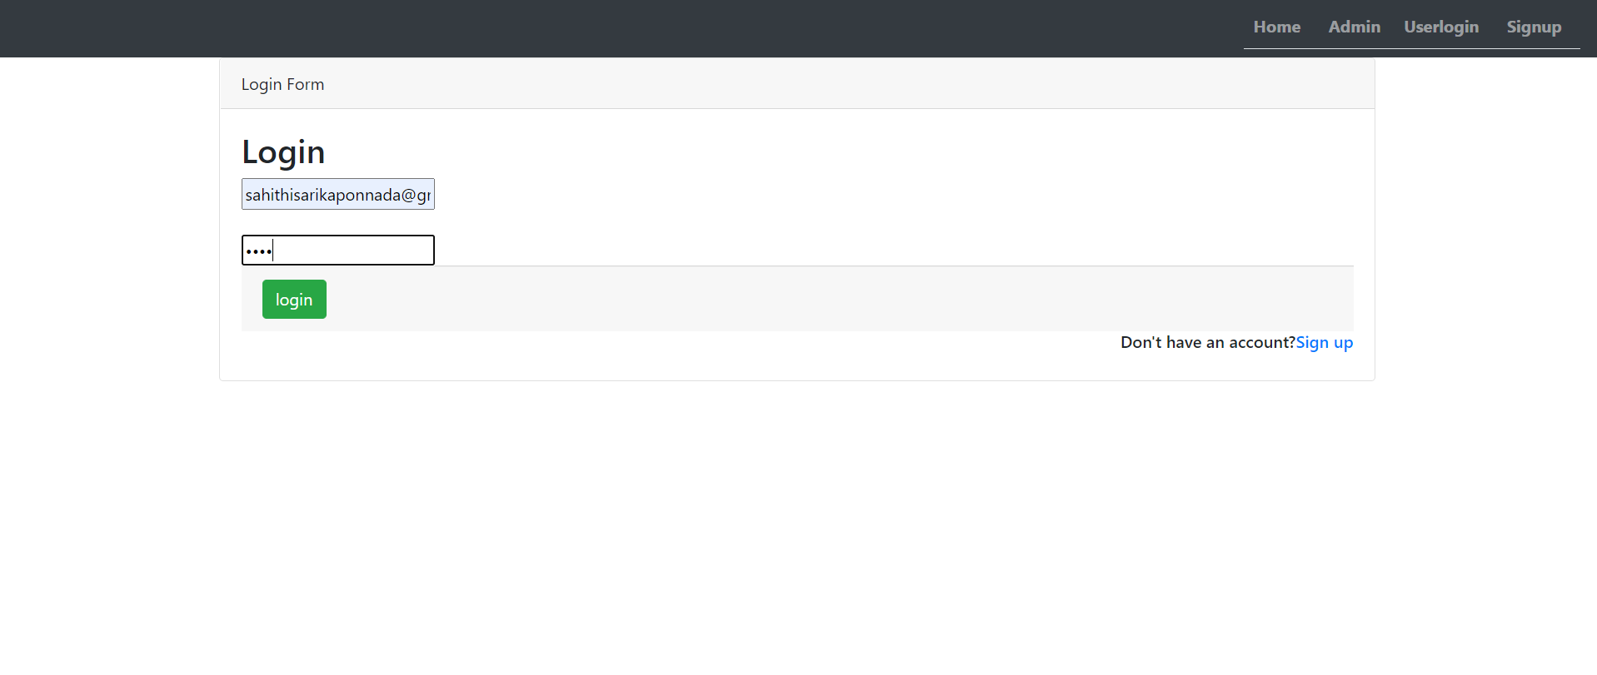
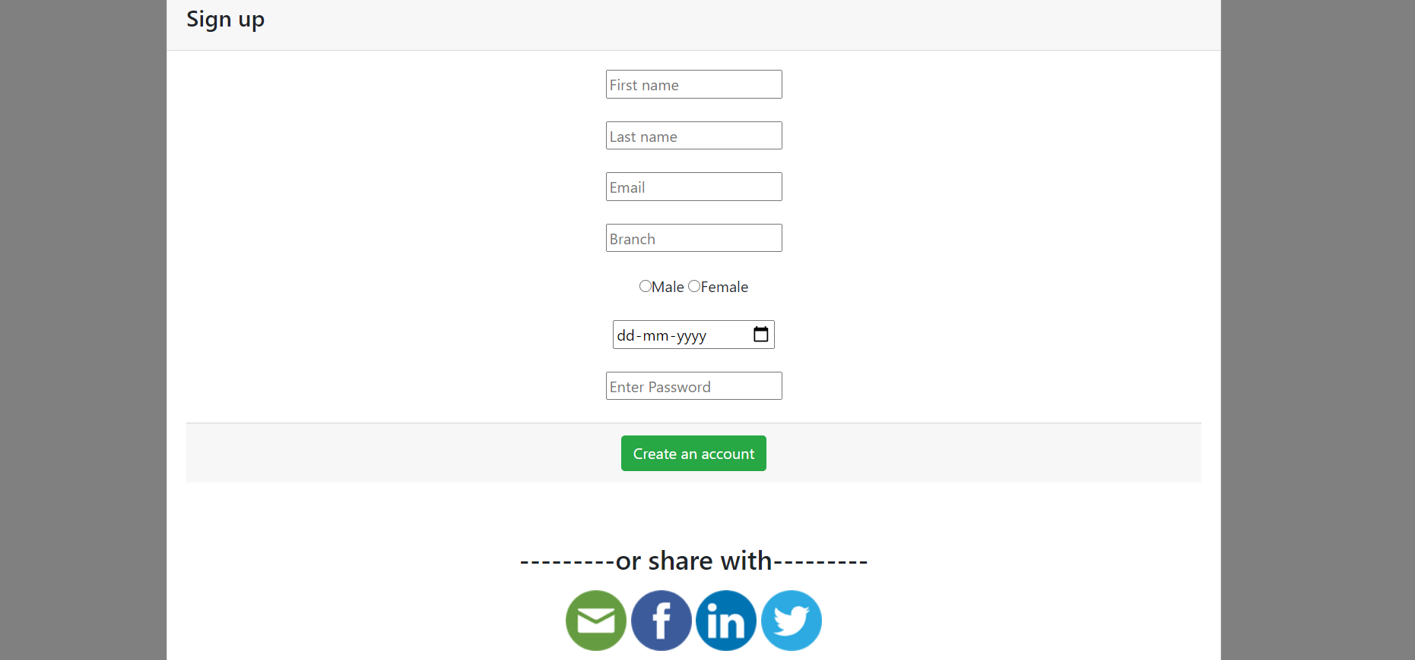
fg7
fg8

Slide 14
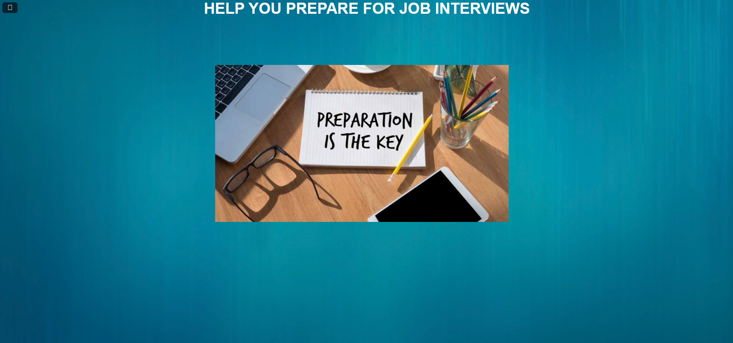
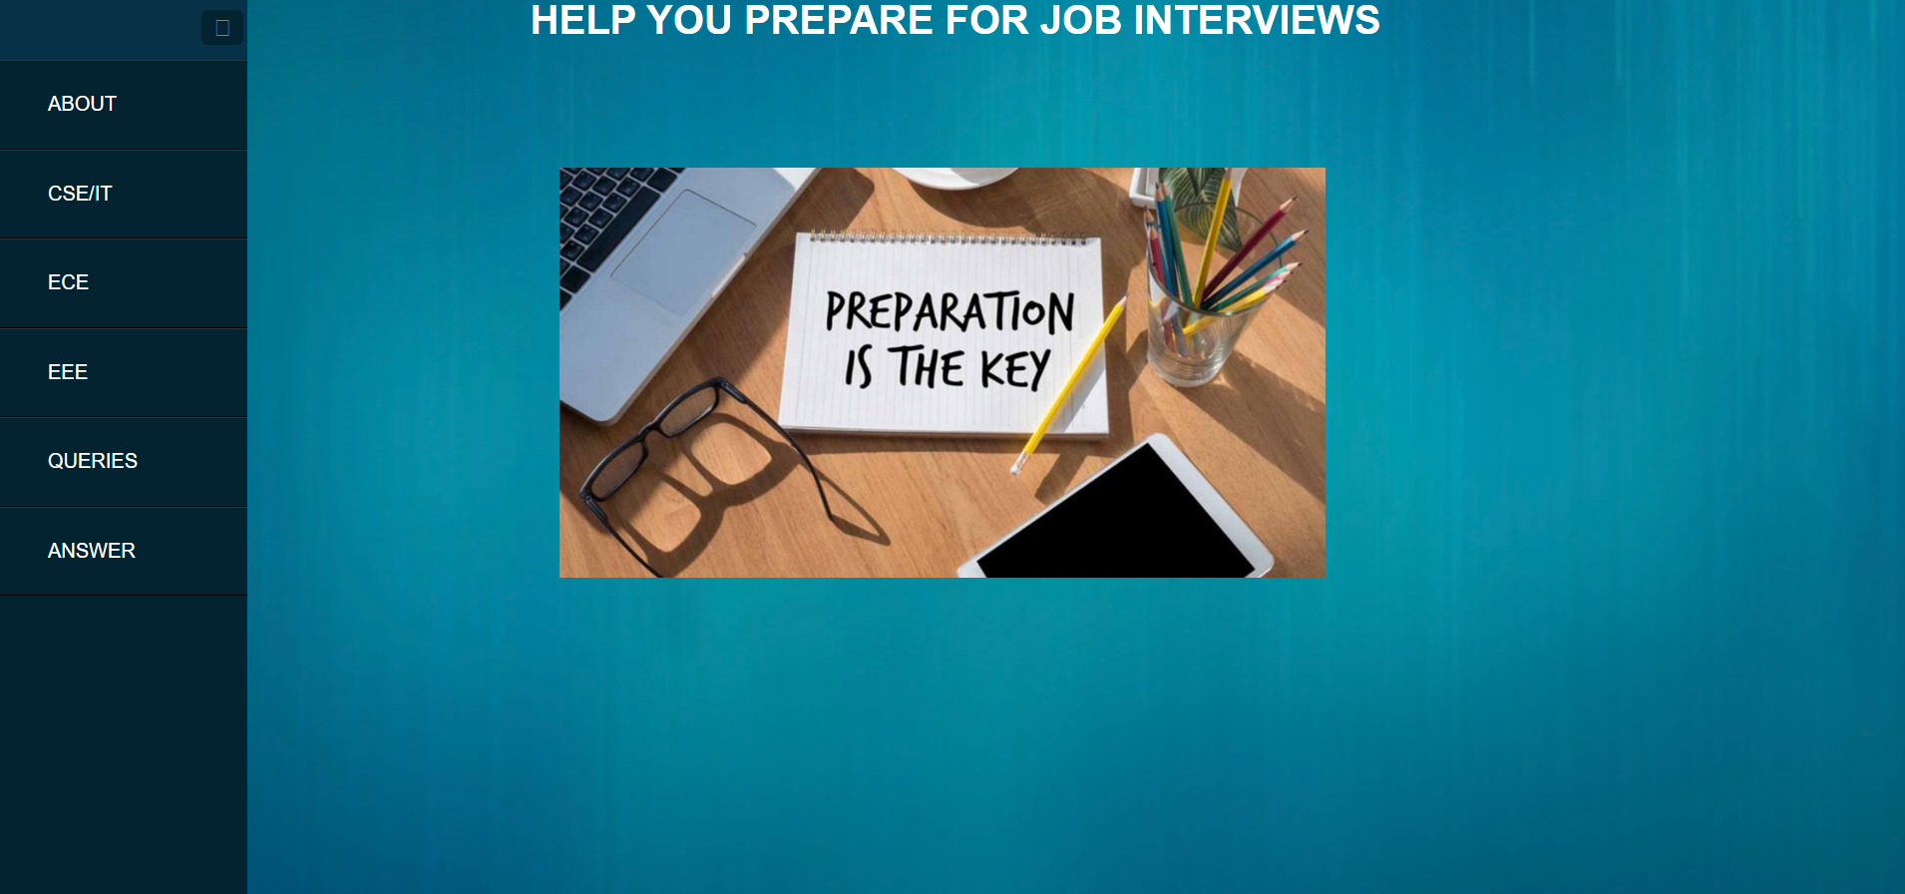
fg9
fg10

Slide 15
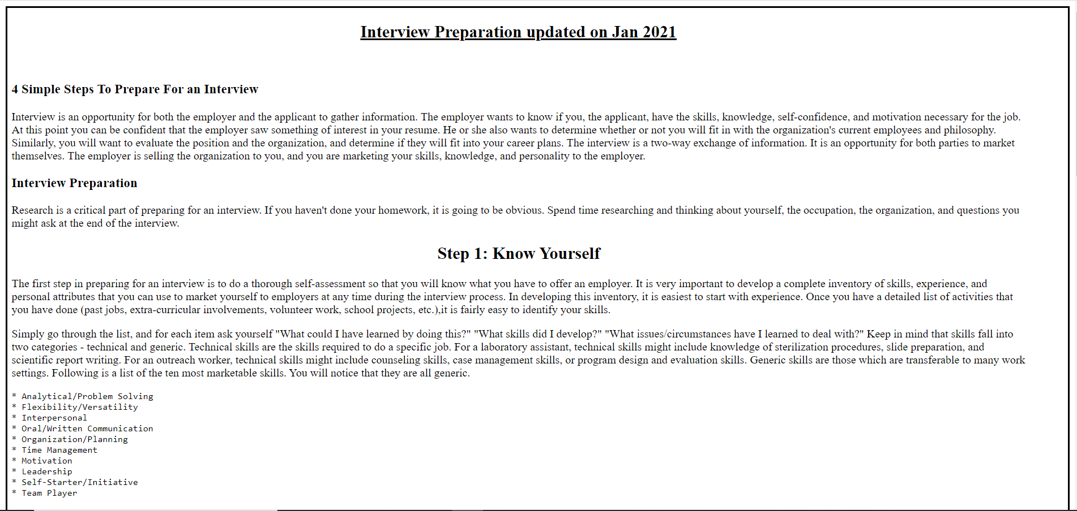
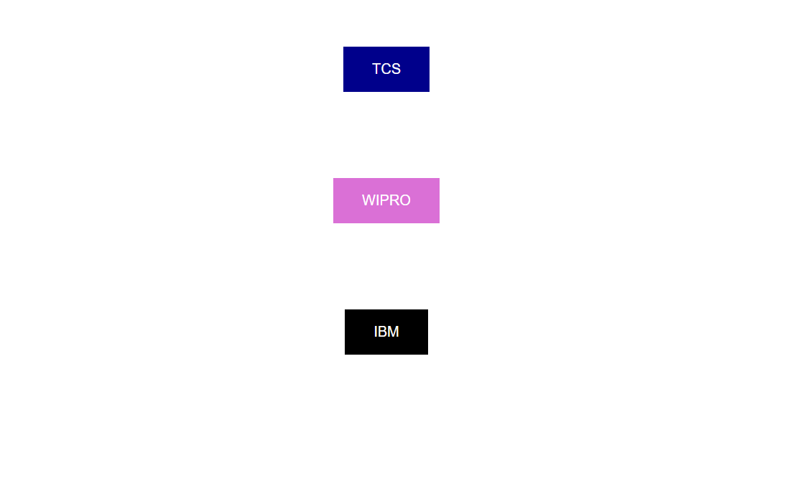
fg11
fg12

Slide 16
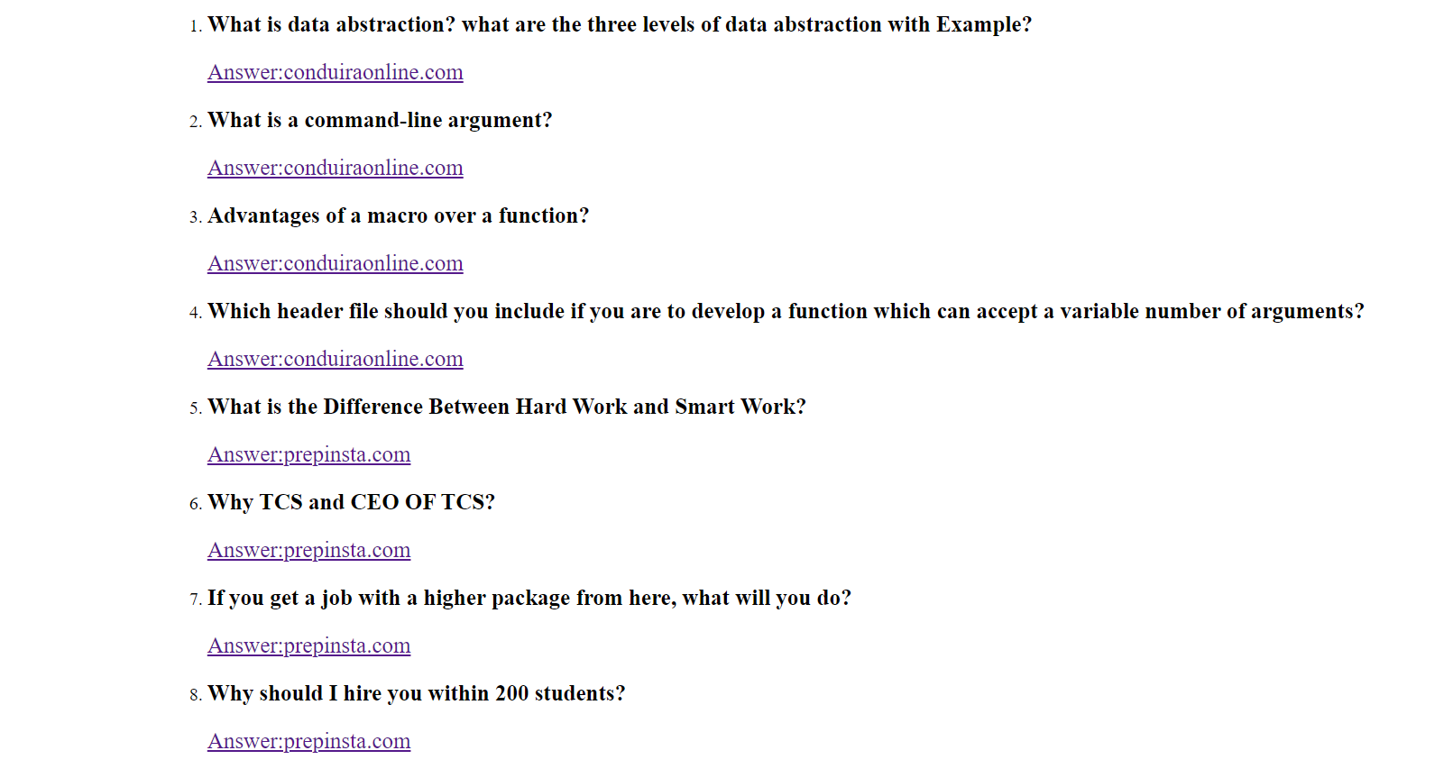
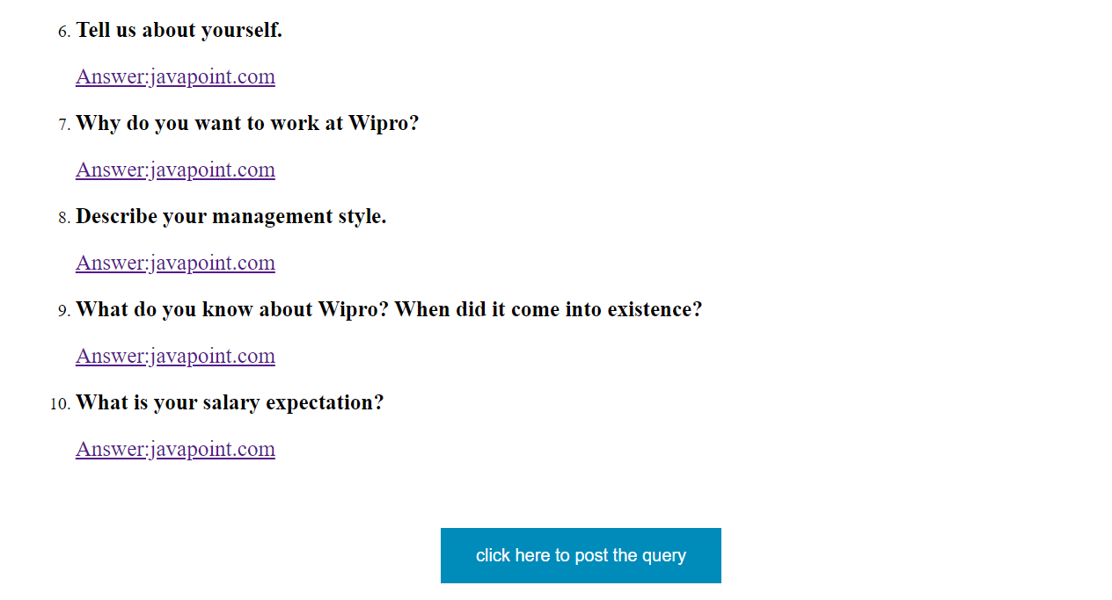
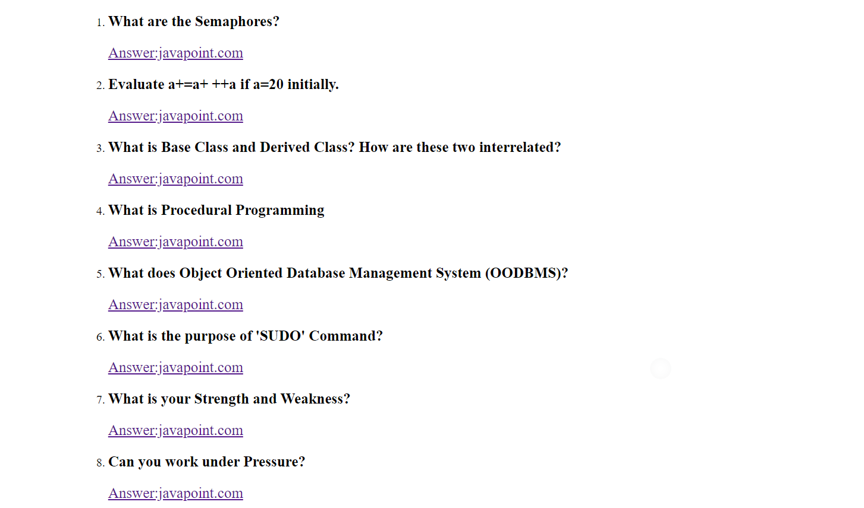
fg13
fg14
fg15

Slide 17
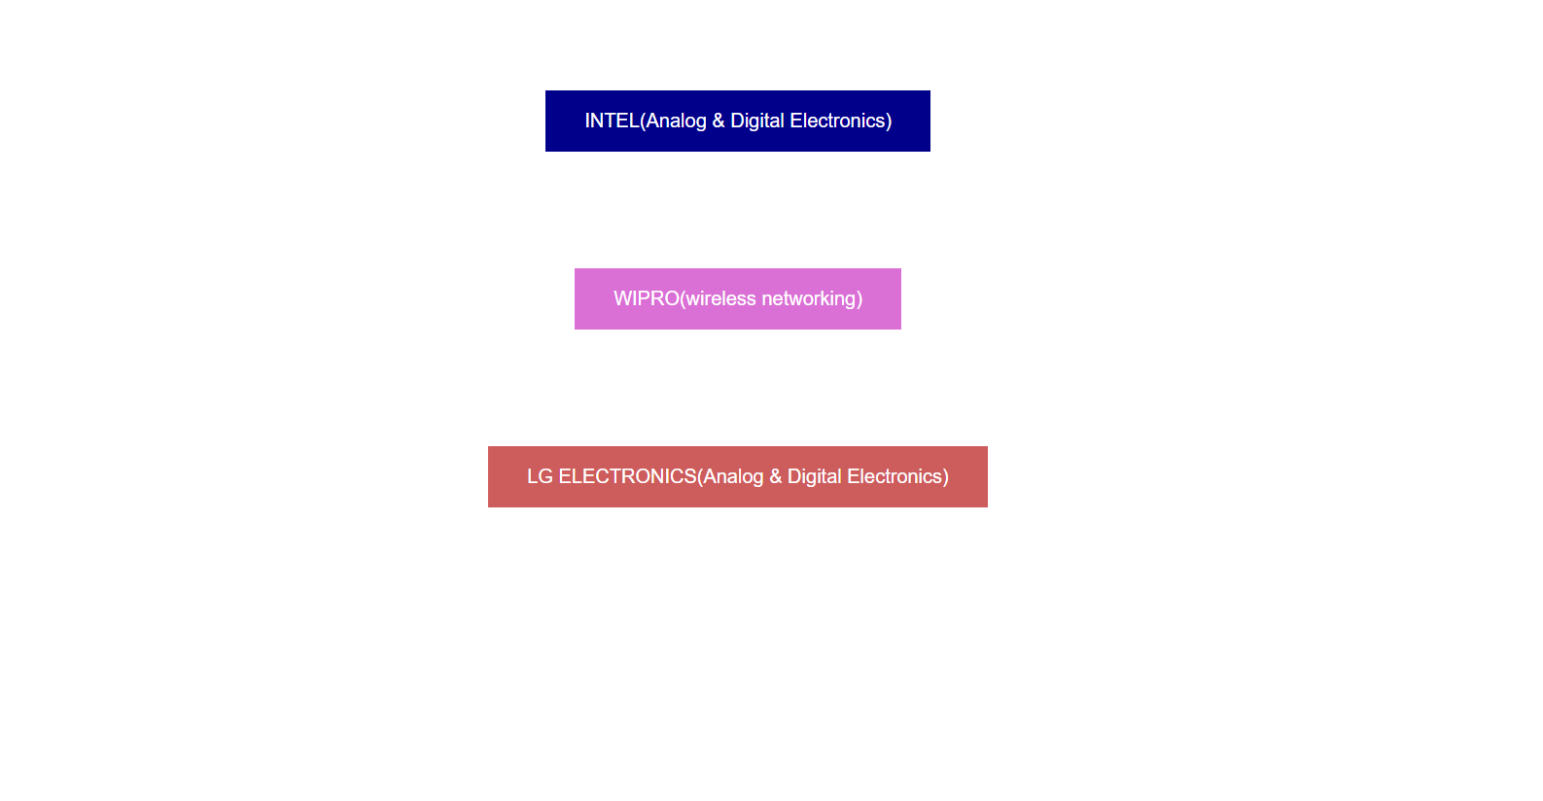
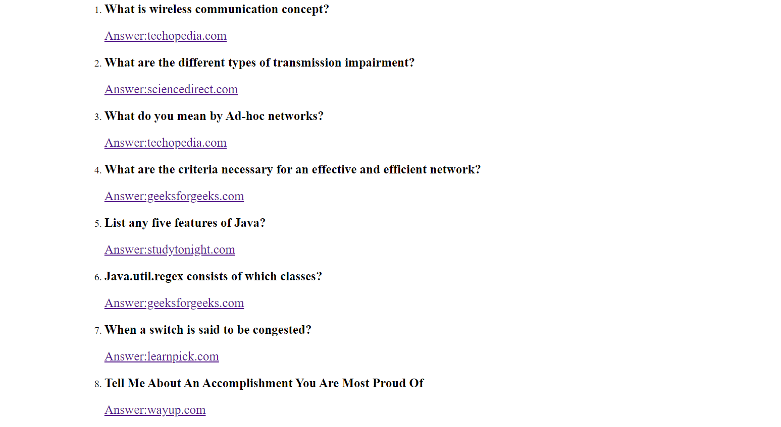
fg16
fg17

Slide 18
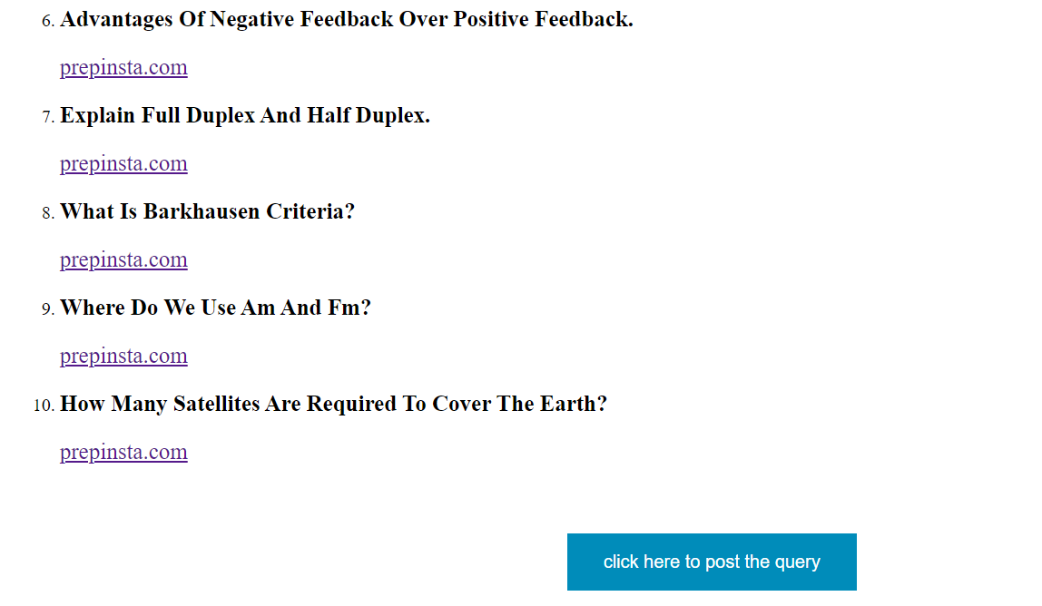
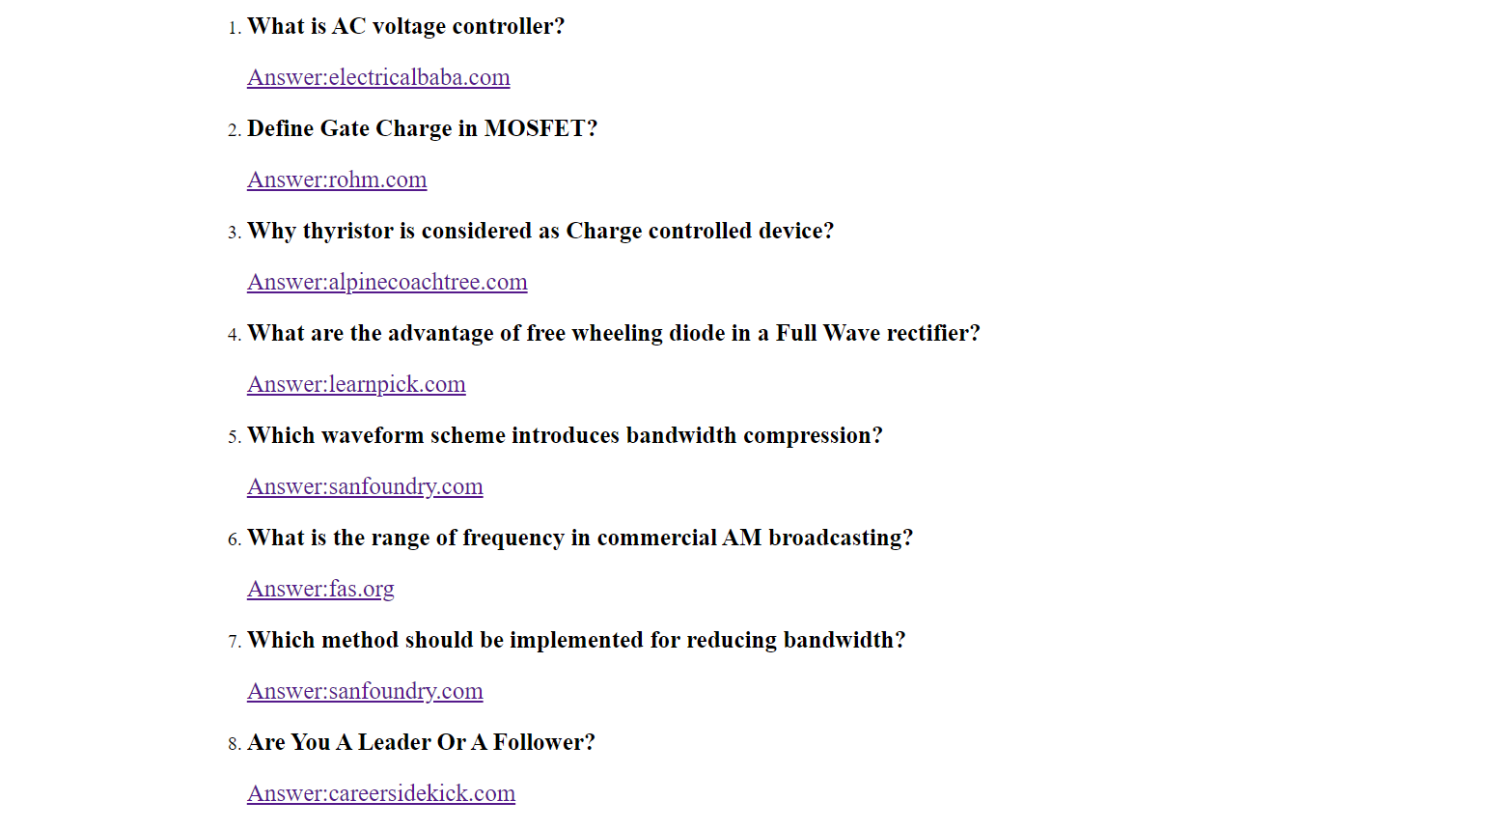
fg18
fg19

Slide 19
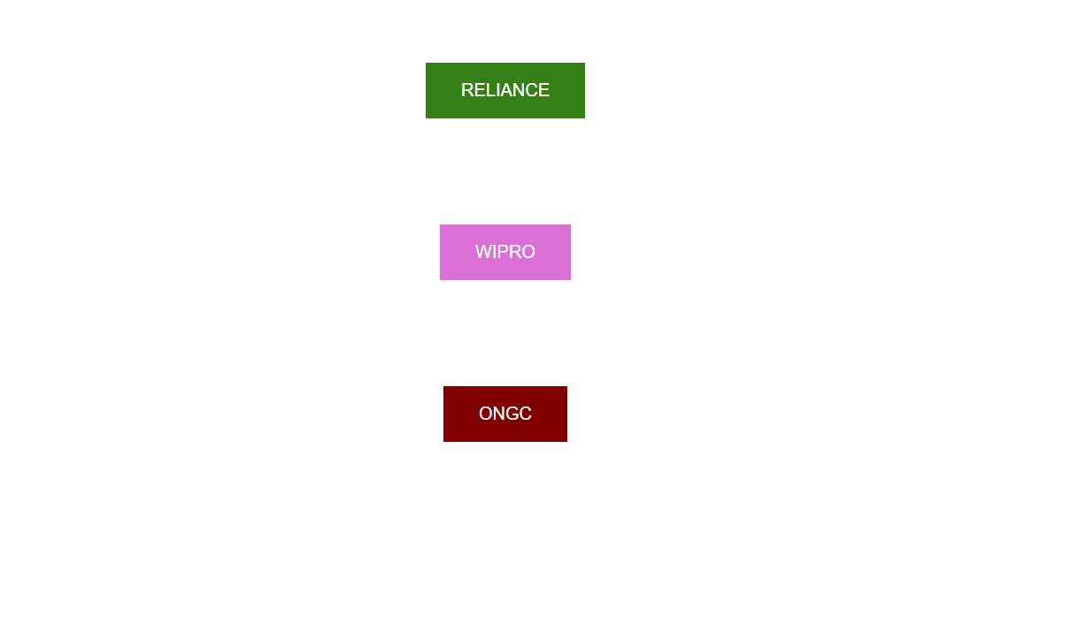
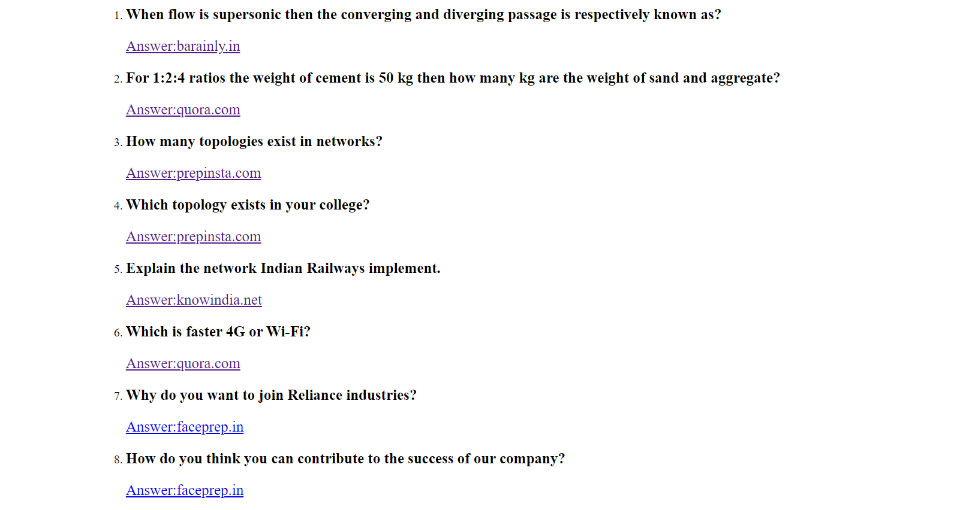
fg21
fg20

Slide 20
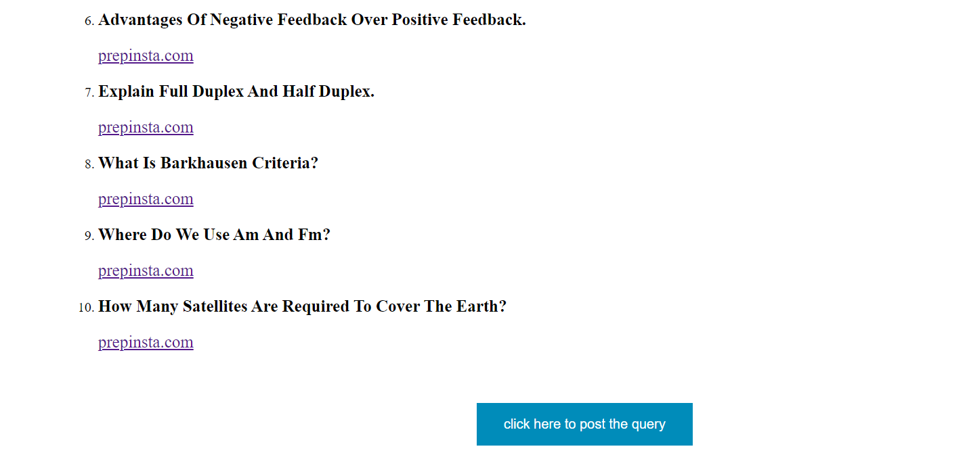
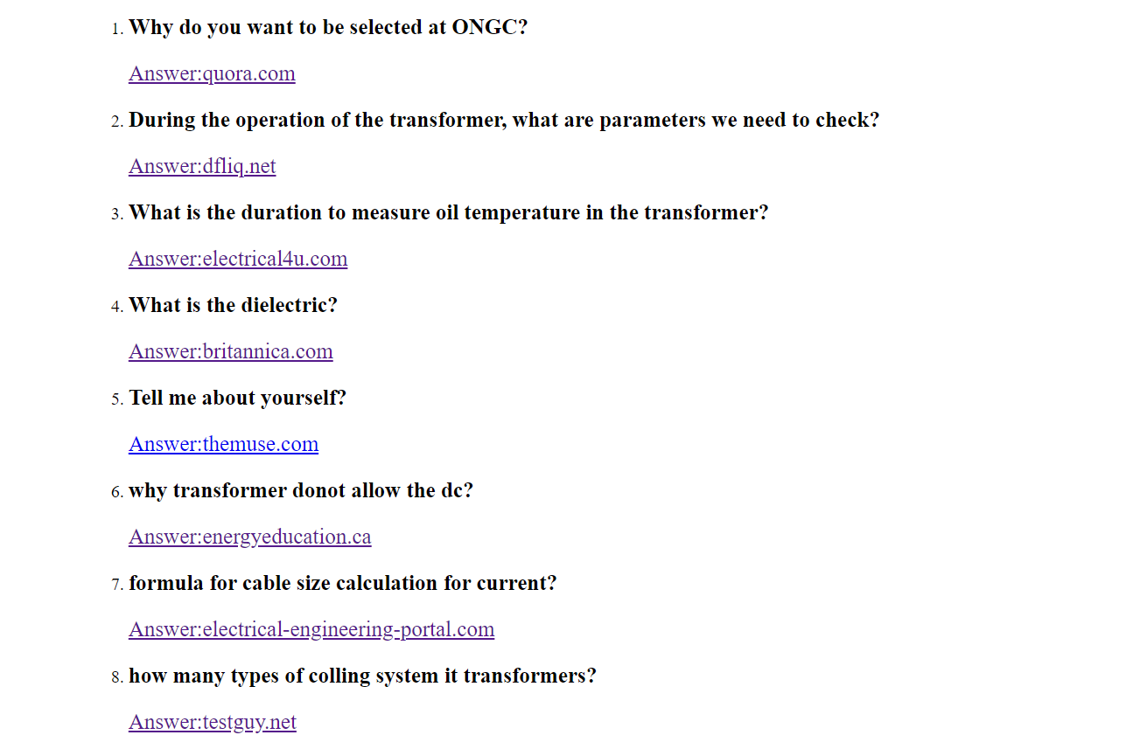
fg22
fg23

Slide 21
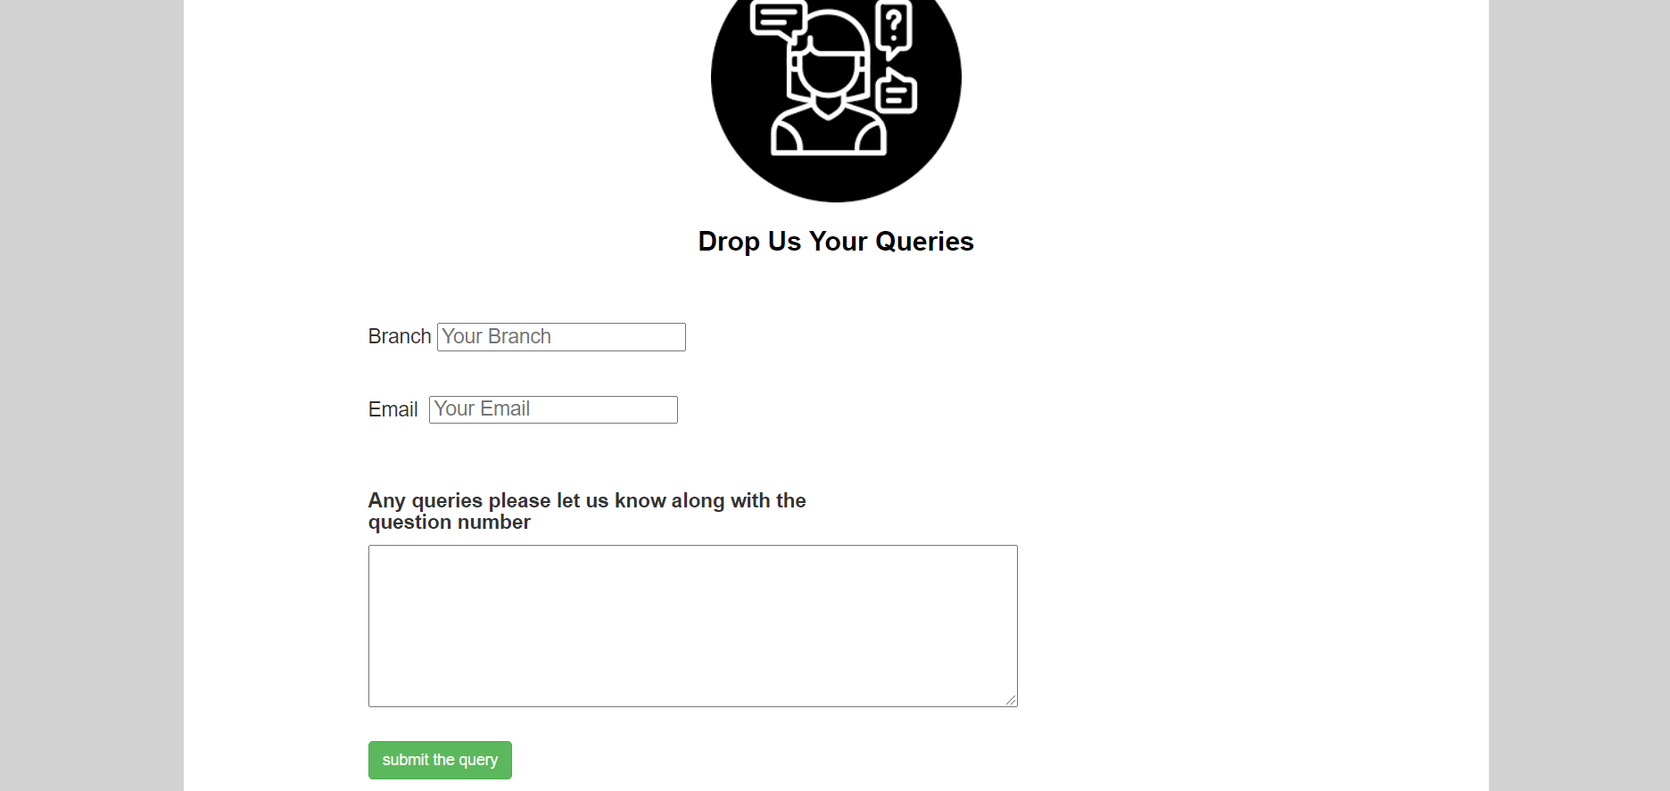
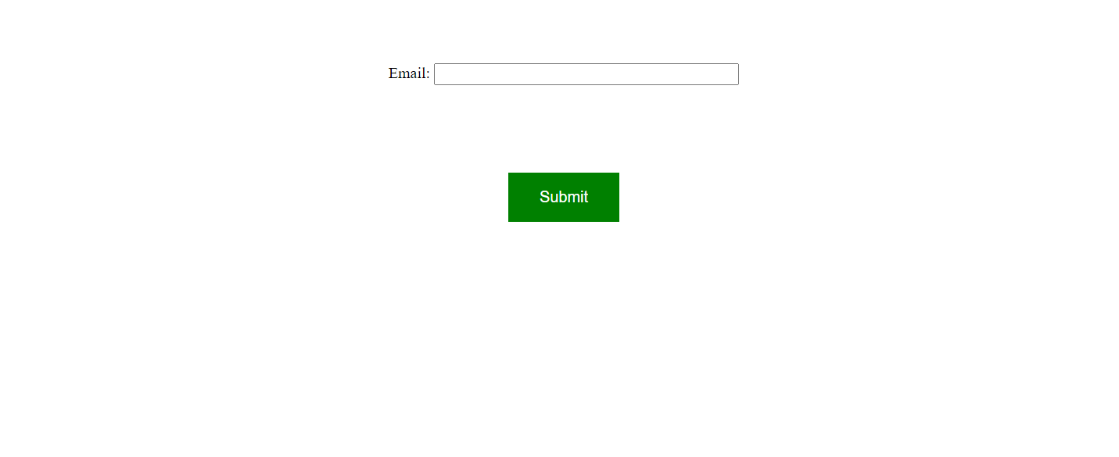
fg24
fg25
fg26

Slide 22
CONCLUSION :
Interview preparation portal is very helpful and needy to the students for last minute preparation . It saves searching time and reduces effort .
“A JOB INTERVIEW IS NOT A TEST OF YOUR KNOWLEDGE , BUT YOUR ABILITY TO USE IT AT THE RIGHT TIME.”

Slide 23
REFERENCES :
. https://youtu.be/V0O4pY2xX10
. https://youtu.be/yaTLj4BB0T4
. https://youtu.be/zY7q-37xYg8
. https://youtu.be/uyaV_EWWRmo
. https://youtu.be/lEpubtYsVzI
. https://www.w3schools.com/bootstrap/bootstrap_ver.asp
. https://www.w3schools.com/css/default.asp
. https://www.w3schools.com/html/default.asp
. https://www.w3schools.com/js/default.asp
. https://www.google.com/search?q=gayatri+vidya+parishad+logo

Slide 24
THANK YOU

